Slide 1



Thynk Unlimited
Home
About
Content
Others
MV COMMAND IN LINUX
Lkhagva-Ochir 202339663
Linux

Slide 2
Thynk Unlimited
Home
About
Content
Others
What is MV?
mv stands for move
Used to:
- Move files/directories to another location
- Rename files or directories
Part of all Unix/Linux systems

Slide 3
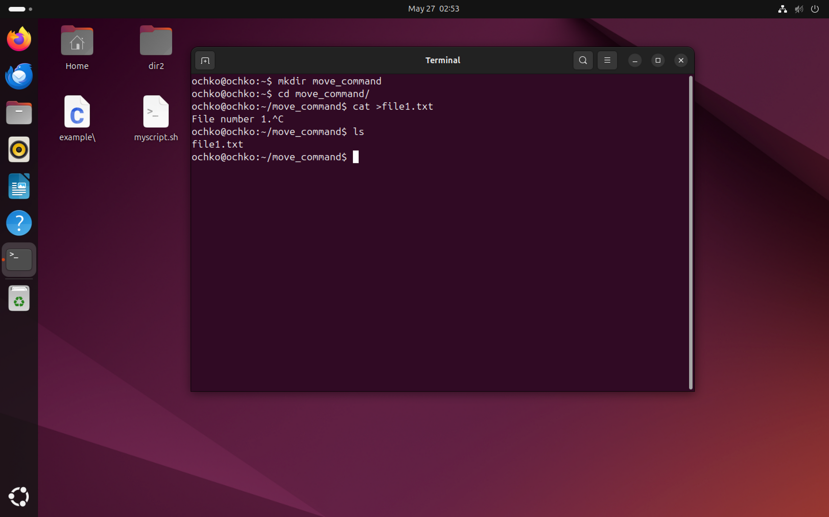

Slide 4
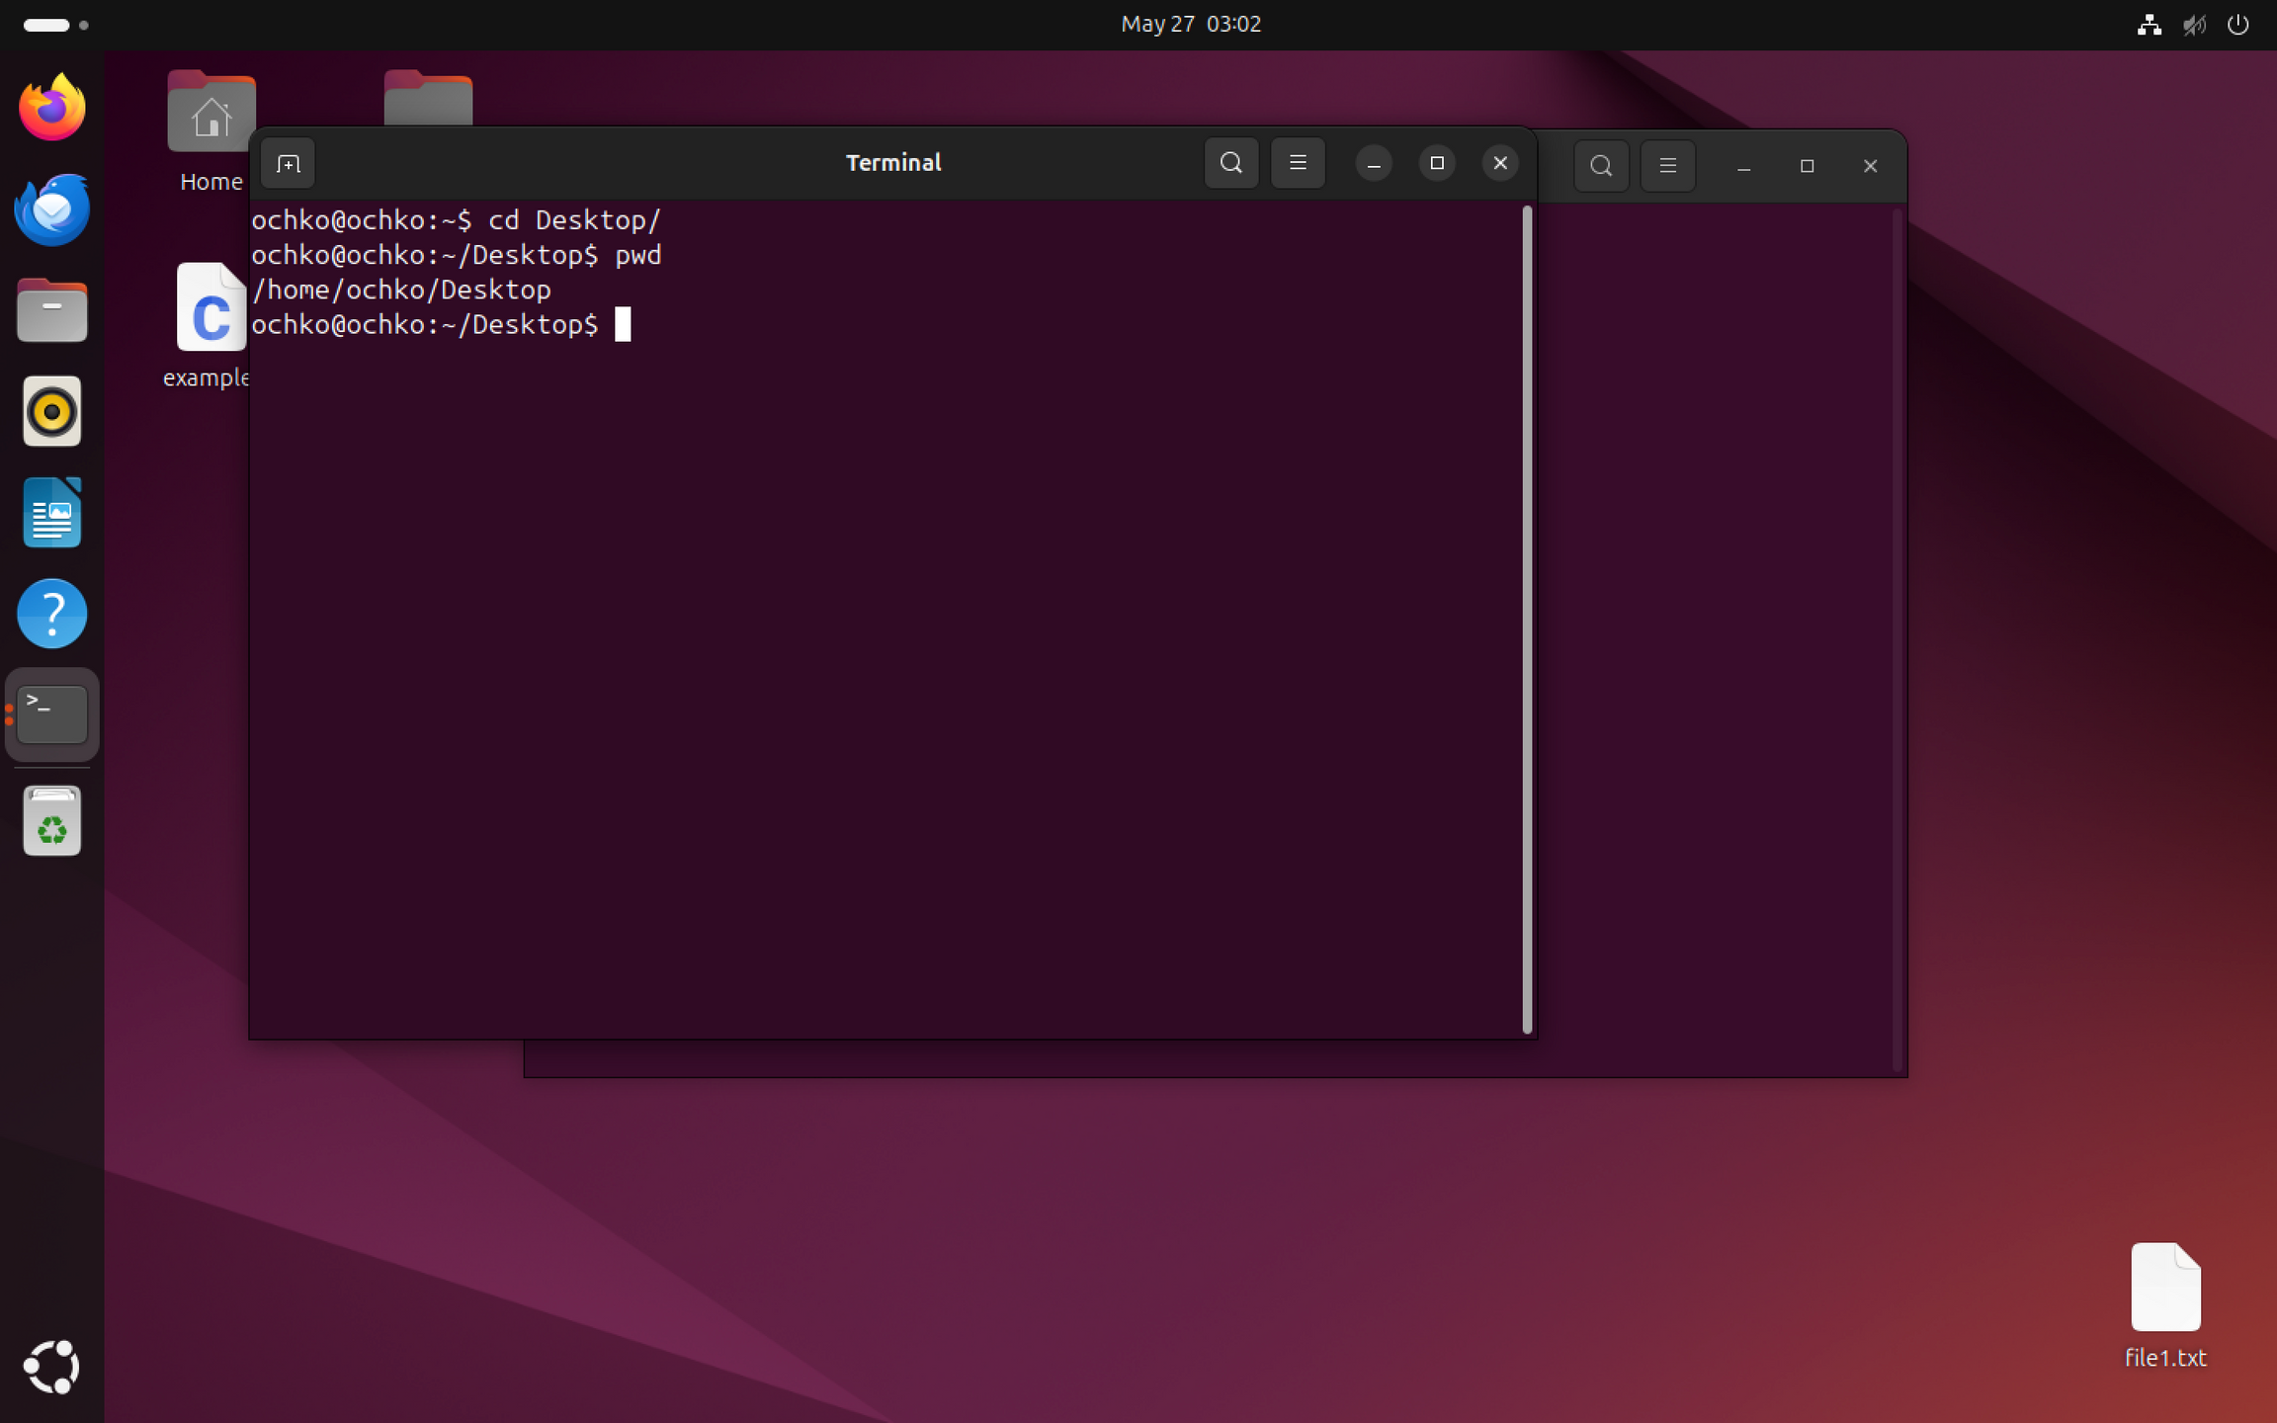

Slide 5
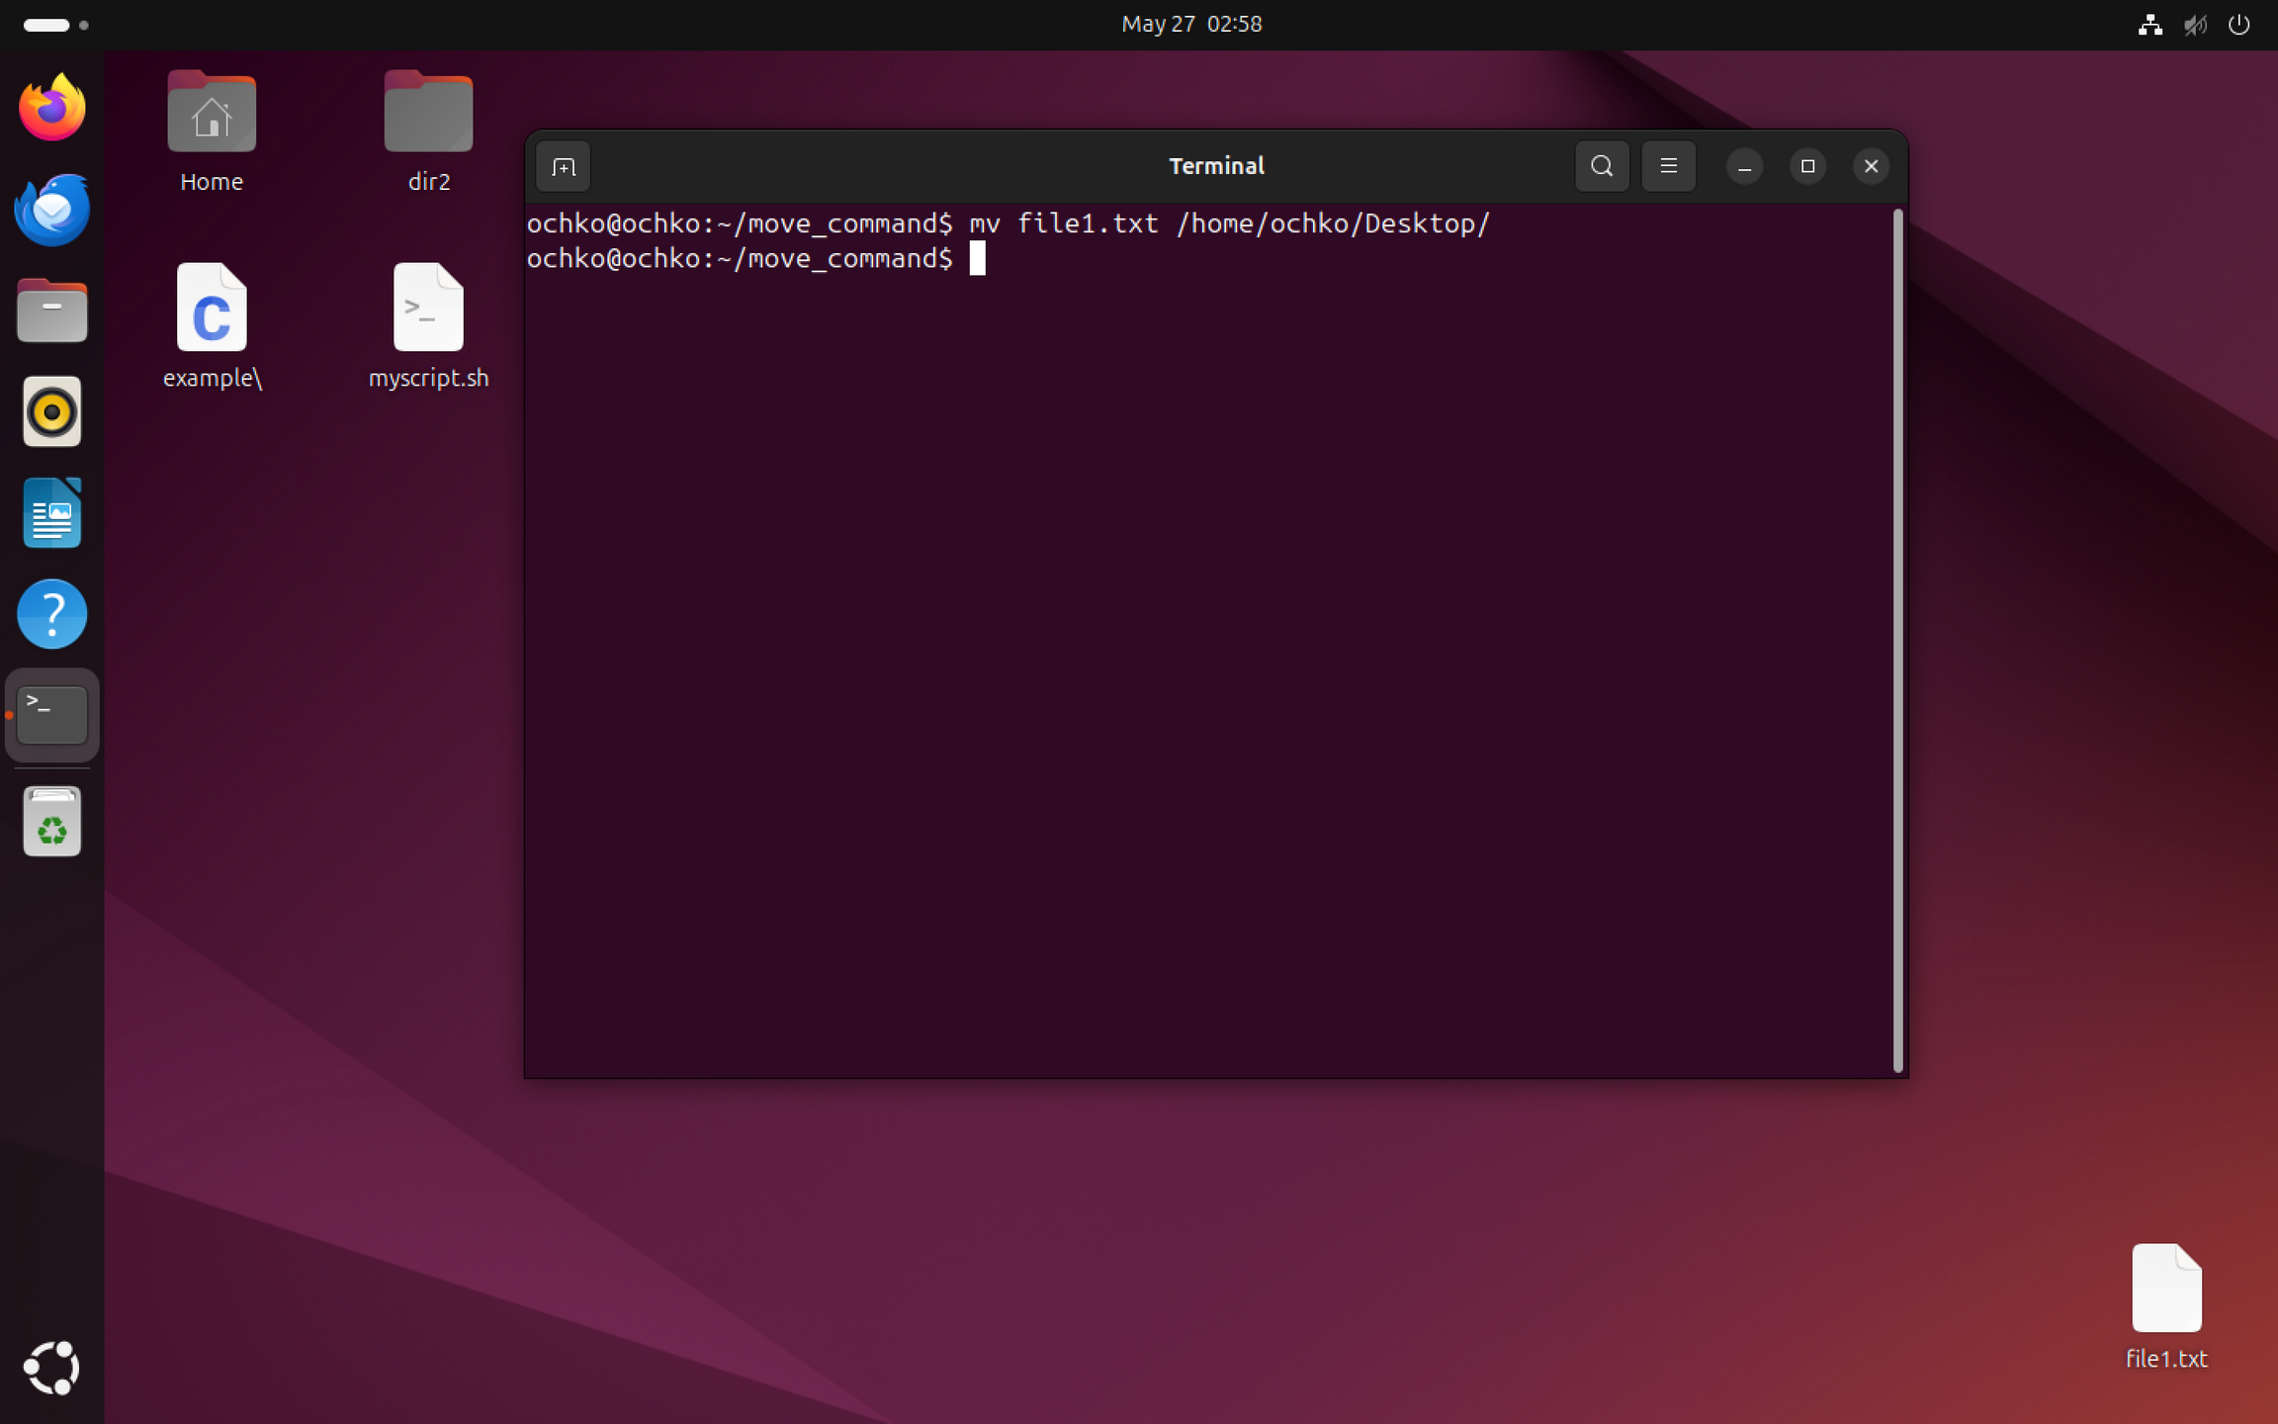

Slide 6
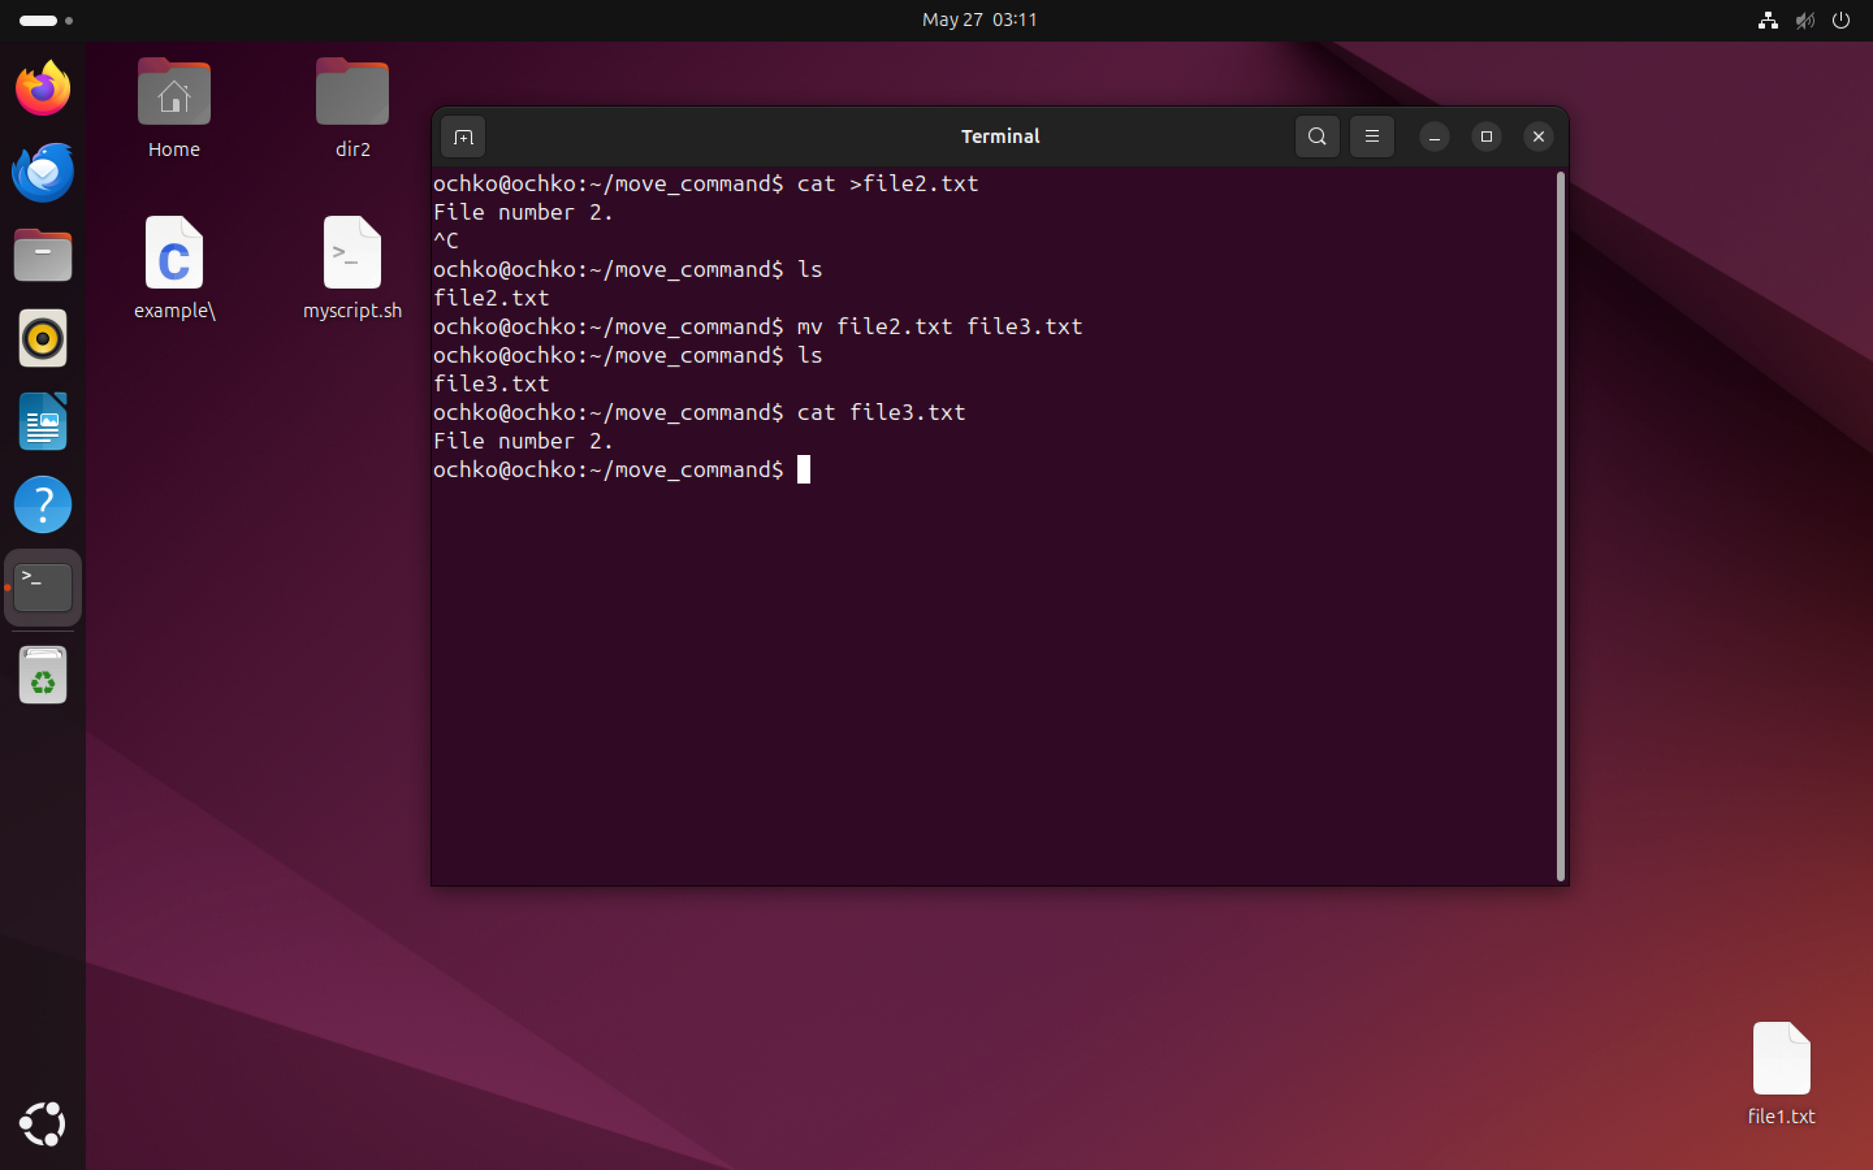

Slide 7
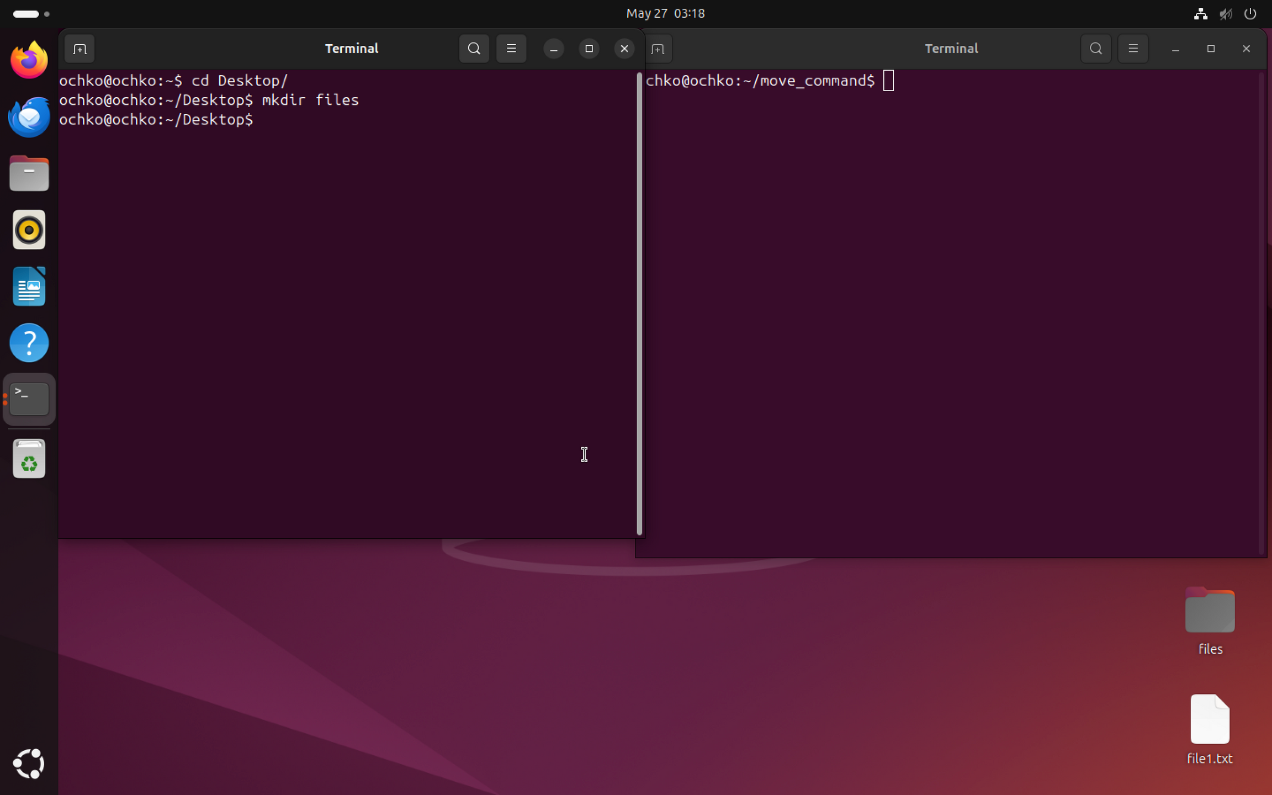

Slide 8
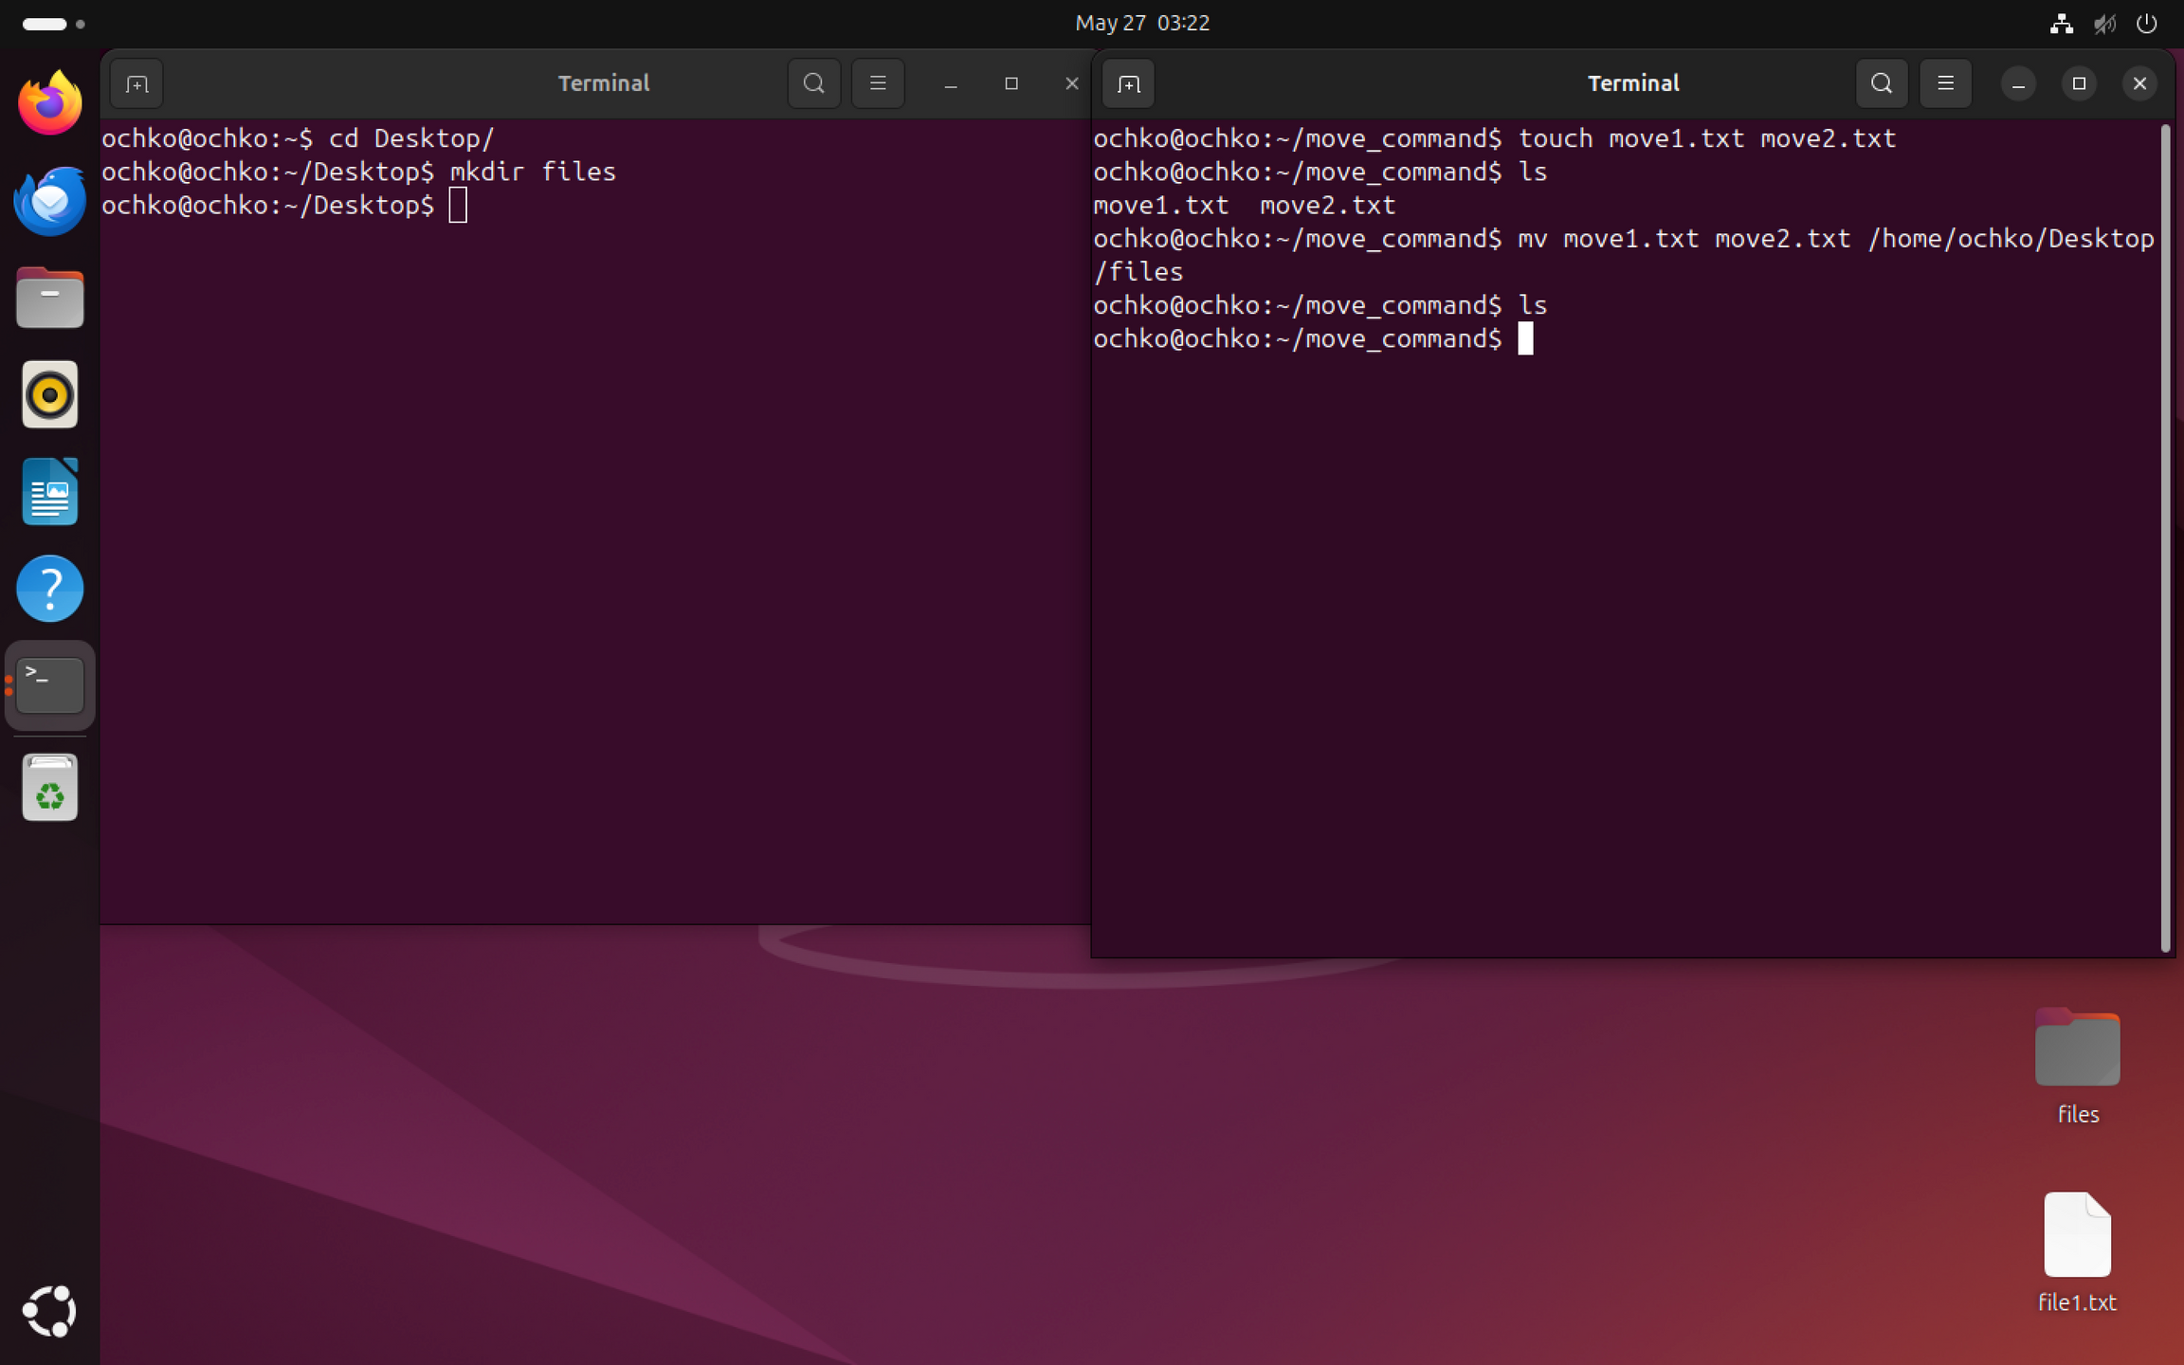

Slide 9
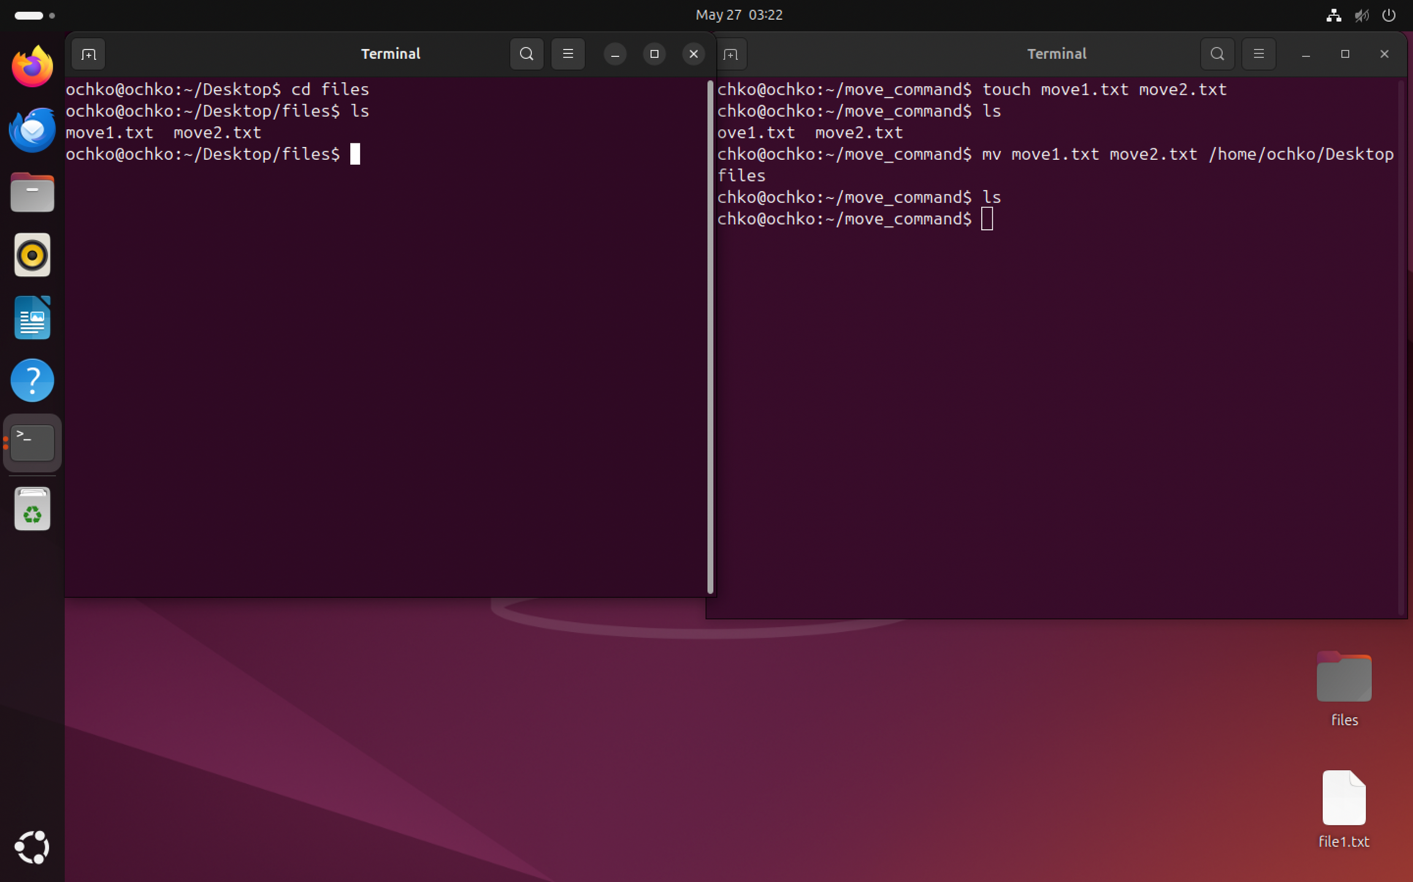

Slide 10
Thynk Unlimited
Home
About
Content
Others
Useful options:
-i | Interactive | Prompts before overwriting existing files
-f | Force | Overwrites without asking — use with caution
-u | Update | Moves only if the source is newer or doesn’t exist in the target
-v | Verbose | Shows what’s being moved — helpful in automation

Slide 11
Thynk Unlimited
Home
About
Content
Others
Conclusion
Move and rename in one command
Simple but powerful
Essential for scripting, file management, and automation
Once you start scripting or handling many files, knowing how to use mv properly becomes critical.

Slide 12
Thynk Unlimited
Home
About
Content
Others
THANK YOU

